Slide 1


Community Detection in Netflix Dataset to Model Recommendation Engine
SHILPA REJI 20MAI1010
ALINA MARY SABU 20MAI1022

Slide 2
Introduction
Development of Internet and computer science, a lot of people join social networks. People communicate with each other and express their opinions on the social media, which forms a complex network relationship
Individuals in the social networks form a "relation structure" through various connections which produces a large amount of information dissemination. This "relation structure" is the community that we are going to research
Community detection is very important to reveal the structure of social networks, to know people's views, analyze the information dissemination and grasp as well as control the public sentiment
In recent years, with community detection becoming an important field of social networks analysis, a large number of academic literature proposed numerous methods of community detection. Here, we first describe community detection in Netflix dataset. Then we classify the different communities obtained to a model recommendation system

Slide 3
Objective
Community detection in Netflix dataset aims to organize the nodes of the network in groups or communities such that nodes belonging to the same community are densely interconnected but sparsely connected with the remaining nodes in the network and to find hidden patterns in the communities to model a better recommendation system

Slide 4
Problem statement
The lack of right data i.e., input data may not always be accurate because humans are not perfect providing ratings.
User behavior is more important than ratings.
So community based recommender systems for Netflix suggest resources such as movies and series based on group of users that manifest similar preferences and behaviors one another.

Slide 5
Literature Survey
Review on Community Detection Algorithms in Social Networks
In the research of community detection, the academic community has made a lot of valuable achievements and proposed many effective methods, which characterized communities from different perspectives. However, with the development of the Internet, social networks are becoming more and more complex; there still exist many problems waiting further research.
A Review of Community Detection Algorithms in Signed Social Networks
It has presented an overview of the community detection algorithms in signed social networks. Some existing approaches are illustrated with the main focus on input parameters which are used to perform community detection while some of them are automatic approaches where input parameter is not required to perform community detection. In the future the applicability domain of the existing algorithms can be enhanced so that the algorithms can also find communities in dynamic graphs also.

Slide 6
An Empirical Study of Community and Sub-Community Detection in Social Networks Applying Newman-Girvan Algorithm
In this paper, it has presented an empirical study of Newman-Girvan algorithm on various data sets. Our results differ from those presented earlier in the sense that we have defined a new concept of sub-communities. The main drawback of Newman-Girvan algorithm is the absence of a clear specification on the definition of what constitutes a community. A lot has been left out for individual interpretations. The problem increases many-folds in cases of unsupervised datasets. The user has to manually identify the major communities from the dendrograms structure. As a future work, we hope to apply the concept of multi-objective function to detect the stable communities in social networks.
An Adaptive Approximation Algorithm for Community Detection in Social Network
As Proposed Algorithm is more precise then Eigen vector based algorithm based on modularity and computation time. Aim to use this algorithm for complex and dense network as network contains many overlapping nodes and crossed edges. In future, we are looking to implement community detection algorithm for following properties:
1. Overlapping Community
2. Interest Based Community Detection

Slide 7
Influence Propagation Model for Clique-Based Community Detection in Social Networks
In this paper, it propose an approach to detect temporally active and dense communities, making use of the biased density metric and the influence of active users with the frequency of their interactions with the neighbourhood. Here also propose an objective function to partition the graph by decomposing the data and distributing them evenly across the available processors. In the future, we aim to develop a time interval model that combines our influence propagation model and a time interval parameter. This will help in finding dense active communities. The model will incorporate the knowledge of graph structure and node attributes, in addition to time gaps.

Slide 8
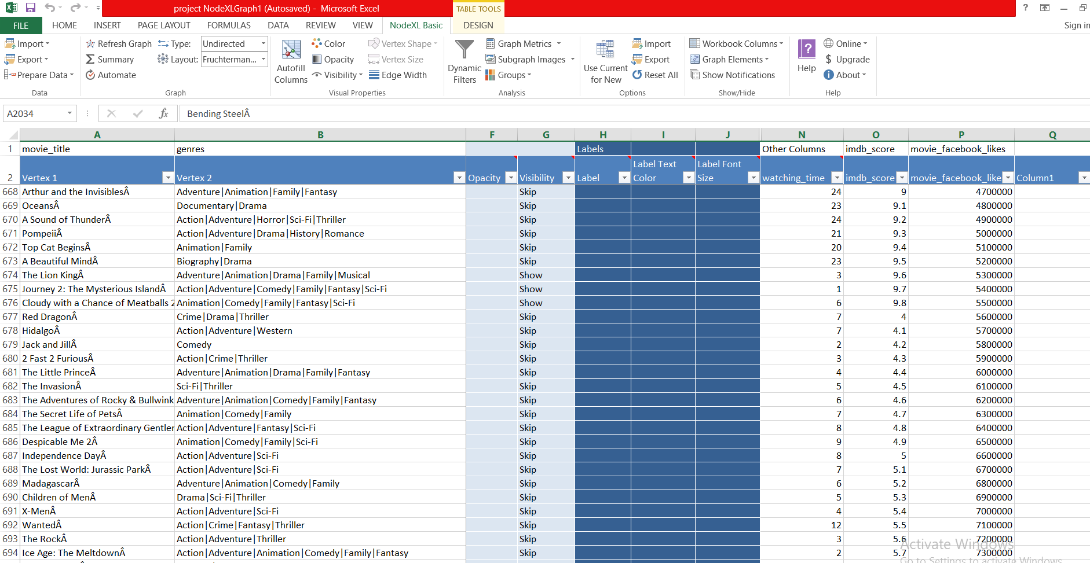
Proposed System
Algorithm used : Clauset-Newman-Moore (Clustering)
Software used : NodeXL Basic
Dataset Used : Netflix Dataset

Slide 9
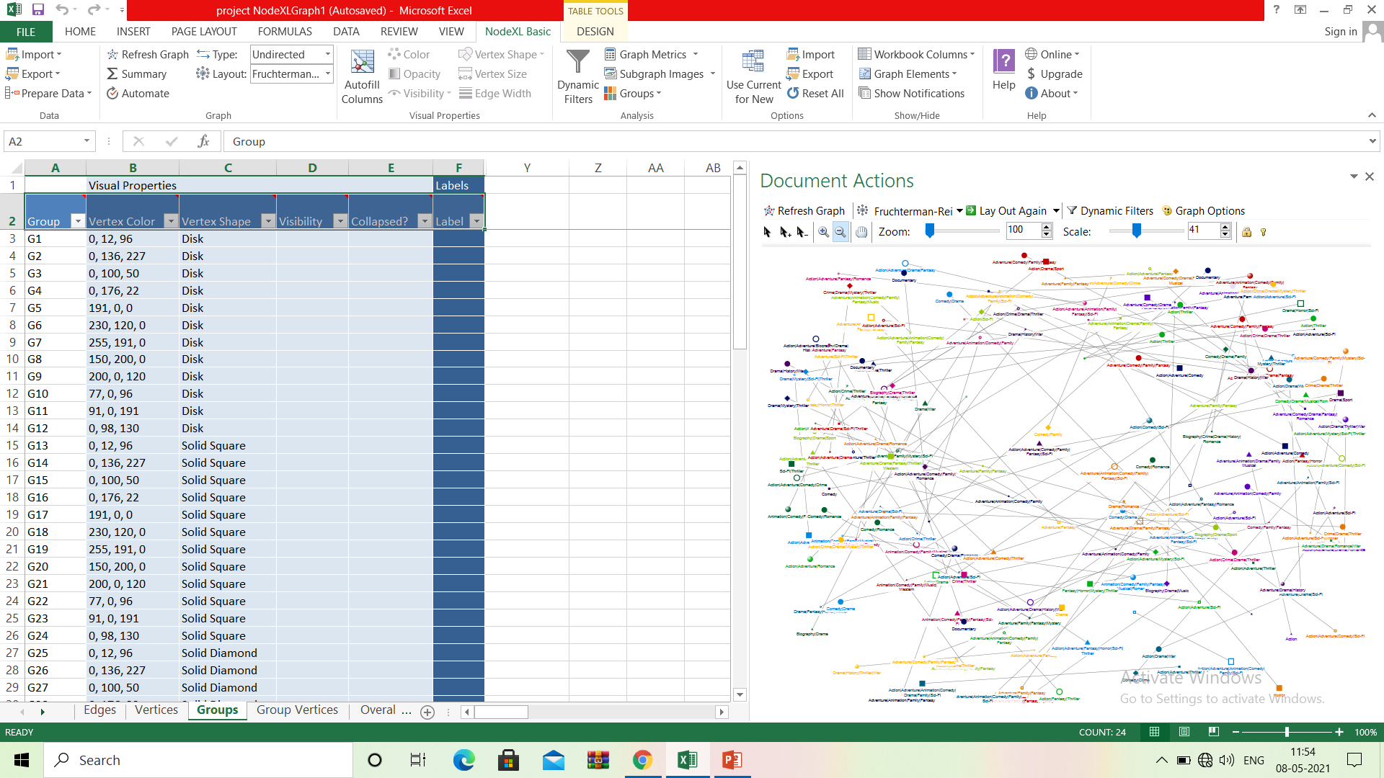
Output

Slide 10


Slide 11


Slide 12


Slide 13
References
Newman,M E J.Fast algorithm for detecting community structure in networks. Physical Review E Statistical Nonlinear and Soft MatterPhysics . 2004.
LEICHT E A, NEWMAN M J. Community structure in directed networks [J]. Physical Review Lerrers. 2008. 100(11):118703
A. Condon and R. M. Karp. Algorithms for graph partitioning on the planted partition model. Random Struct. Algor., 18:116 - 140,2001. Santo Fortunato, Andrea Lancichinetti. Community detection algorithms: a comparative analysis. VALUETOOLS.2009.
A. Lancichinetti, S. Fortunato, F. Radicchi. Benchmark graphs for testing community detection algorithms. Phys. Rev. E, 78(4):046110, 2008.
Mu Zhu. Research on the Key Technologies of Community Detection inComplex Networks. 2014(35).

Slide 14
Von Luxburg U. A tutorial on spectral clustering [J]. Statistics and computing, 2007, 17 (4):395-416.
Kernighan B W, Lin S. An efficient heuristic procedure for partitioning graphs[J]. Bell system technical journal, 1970,49(2): 291-307.
Lin Yuan. Research on Community Detection and Graph Partitioning. 2014 Rosvall, M., Bergstrom, c.T.: Maps of random walks on complex networks reveal community structure. Proceedings of the National Academy of Sciences 105(4) (2008) 1118 - 1123
Overlapping Community Detection in Networks: the State of the Art and Comparative Study. ACM Computing Surveys, vol. 45, no. 4, 2013. I. Derenyi, G. Palla, T. Vicsek, Clique percolation in random networks, Phys. Rev. Lett. 94 (16) (2005) 160202.
G. Palla, I. Derenyi, I. Farkas, T. Vicsek, Uncovering the Overlapping Community Structure of Complex Networks in Nature and Society, Nature 435(2005) 814 - 818.

